Slide 1
INFO 341 VPNs (Virtual Private Network)
By
Bob Larson

Slide 2
Topics
Goals of Network Security
Traditional Network
VPN Connections (Links or Tunnels)
What is a VPN (Virtual Private Network)?
How Encryption Works
What is Authenticated/Encrypted?
The VPN you are already using

Slide 3
Goals of Network Security
Confidentiality
Securing data from prying eyes (encryption)
Integrity
Authenticating the source
Is the sender who they claim to be (can they disavow)
Authenticating the data
Has the data been modified
Availability
Users need reasonable access to data they are authorized to use

Slide 4
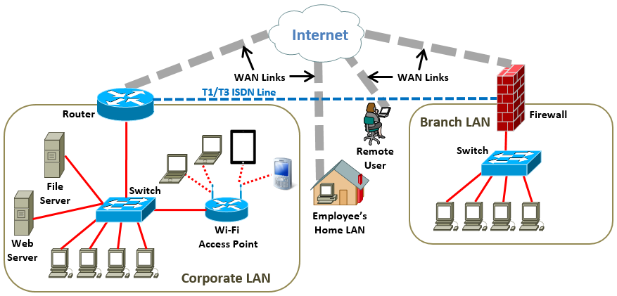
Traditional Network
Internet WAN connections are open to snooping from anywhere in the world
Dedicated lines (point-to-point) are expensive and slow secure connections
T1 (1.54 Mb | T3 44.7 Mb | ISDN 64/128 Kb) shared by all users. Cost based on distance
Expensive to connect employee’s home
Not possible for remote user on the road or at a customer’s site

Slide 5
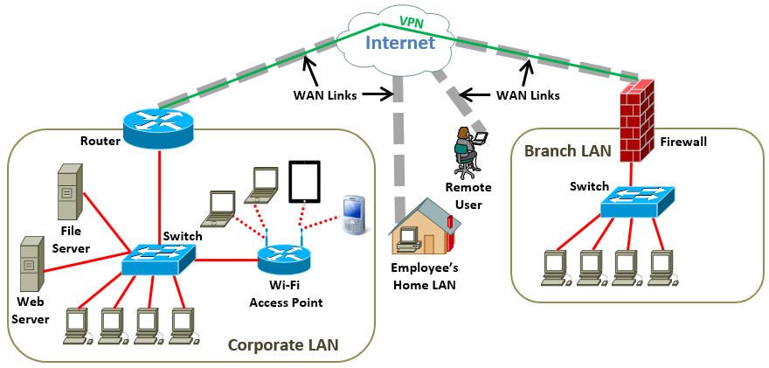

VPN Connections (Links or Tunnels)
Common (but weak) VPN analogy is a secure pipe running through the Internet
Better analogy is a Limousine or armored car moving through traffic
Nobody knows who or what is inside or where it is coming from or going
Low cost (can be free) and relatively easy to setup even for home or remote users
Can be edge device to edge device | user device to edge device or directly to a server

Slide 6
What is a VPN (Virtual Private Network)?
Virtual point-to-point link between computer(s) or edge device(s)
Traffic is then encrypted (scrambled)
It can be seen (still 0s/1s) but not understood
Extends a private network across a public network (Internet)
Much like a direct connection to the private network (only slower)
Access to resources of the private network as if they were on site
VPN protocols – often used in combinations
Internet Protocol Security (IPSec)
Layer 2 Tunneling Protocol (L2TP) – often combined with IPSec
Point-to-Point Tunneling Protocol (PPTP) uses Point-to-Point Protocol (PPP) to encrypt
Secure Sockets Layer (SSL) and Transport Layer Security (TLS)
OpenVPN an open source VPN
Secure Shell (SSH)

Slide 7
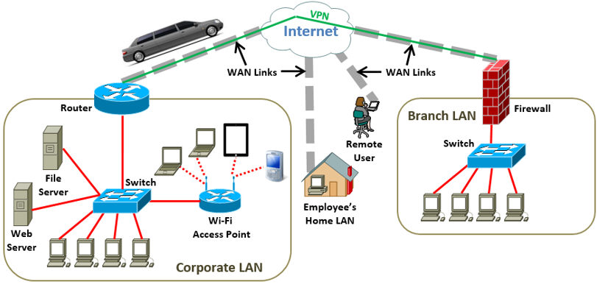
Types of VPNs
Remote Access VPN
Allows a user to connect to a private network’s services and resources remotely
Corporate employee, while traveling or working from home
Private users, bypass regional Internet restrictions and access blocked websites
Enhance their Internet security and privacy including over WiFi (Airports / Starbucks)
Site-to-Site VPN (Router-to-Router VPN)
Mostly by companies to connect offices in different geographical locations
Basically a virtual bridge between the networks of geographically distant offices
Maintain a secure and private communication between the networks
Starts only after an authentication is validated between the two sites
Intranet VPN – Connects two company locations together
Extranet VPN – Connects company office of another company

Slide 8
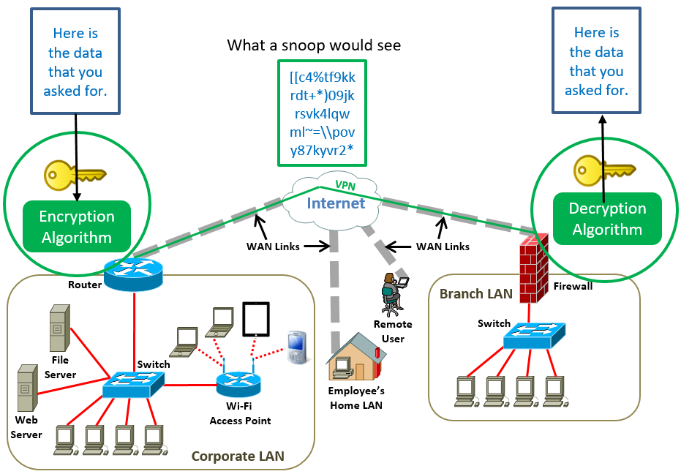
How Encryption Works
A
R
In this example all data from Corporate LAN would be encrypted at the router and decrypted by the firewall before forwarding into the Branch LAN
For traffic going the other way, the process would be reversed.
The “key” is a word, phrase, or number that the algorithm uses to scramble and unscramble the messages.
Either encryption or decryption could be done on a computer, thereby tunneling through the router and/or firewall as well. This would be the norm for remote users.
Note: The firewall and any firewall features in the router may need to be configured to allow encrypted data through.
R
A
Note: The entire Packet from A gets encrypted including source and destination IP addresses. That becomes the payload for a new Packet with the Router as the Source IP and the Firewall as the Destination IP. Even if snooped the original sender and recipient are concealed. Like a Limo.

Slide 9
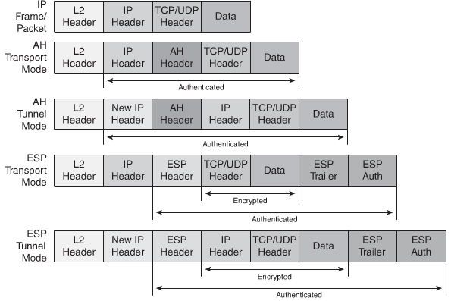
What is Authenticated/Encrypted?
It depends!
Original Frame
IPSec – IP Security
Transport mode encrypts the message in the data packet
Tunneling mode encrypts the entire data packet.
Header inserted
Most Secure

Slide 10

The VPN you are already using
Transport Layer Security (TLS) / Secure Sockets Layer (SSL)
TLS is replacing the older SSL in common usage – still called "SSL”
Encryption protocols for certain applications – your browser is the client
Used for online banking, online sales, and when you logon to MyUW
You can type (or a link supplies): http://myuw.Washington.edu
After login switches you to: https://weblogin.washington.edu
From the point https appears on all communications is encrypted
Easy to use, often invisible to the user
Purist will argue not a true VPN because it doesn’t grant full inside access
Limited to the Application Server you logged onto and any links it provides
Supported by most browsers and mobile Apps
Secure for even public WiFi “Hotspots” if your device isn’t compromised

Slide 11
Fin…

